Slide 1
Zillow data science pipeline
Notes:
Pour changer le logo en pied de page, aller dans AFFICHAGE > Masque > Masque des diapositives : remplacer le logo en place par le logo de votre entité.
Pour éditer la mention de confidentialité, aller dans le menu INSERTION > En-tête et pied de page, et remplir le niveau désiré.

Slide 2
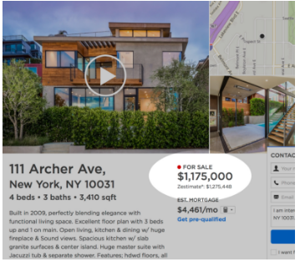
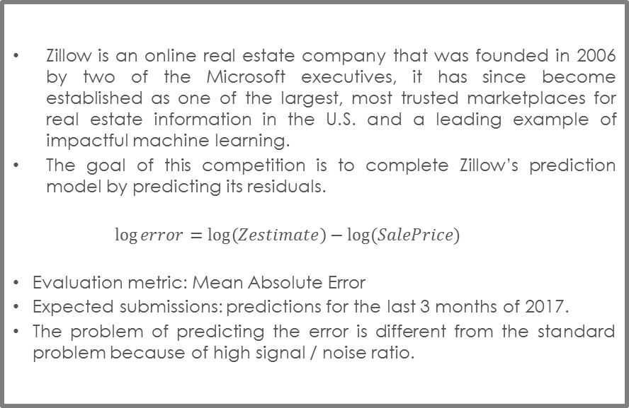
Zillow’s Home Value Prediction
Competition description
Competition description
Zillow is an online real estate company that was founded in 2006 by two of the Microsoft executives, it has since become established as one of the largest, most trusted marketplaces for real estate information in the U.S. and a leading example of impactful machine learning.
The goal of this competition is to complete Zillow’s prediction model by predicting its residuals.
$$\log{error}=\log\left(Zestimate\right)−log⁡(SalePrice)$$
Evaluation metric: Mean Absolute Error
Expected submissions: predictions for the last 3 months of 2017.
The problem of predicting the error is different from the standard problem because of high signal / noise ratio.
Training Set |  |  |  | LB |  | Training Set |  |  |  | Private Leaderboard
 |  |  | 20/10/2016 |  | 31/12/2016 |  |  |  | 20/10/2017 |  | 31/12/2017

Slide 3
Zillow’s Home Value Prediction
Standard Pipeline
Pre-modeling
EDA
(exploratory data analysis)
Data enrichment
Data imputation & cleaning
Modeling
Simple models
More complexe models
Model tuning
Stacking
Model combinations

Slide 4
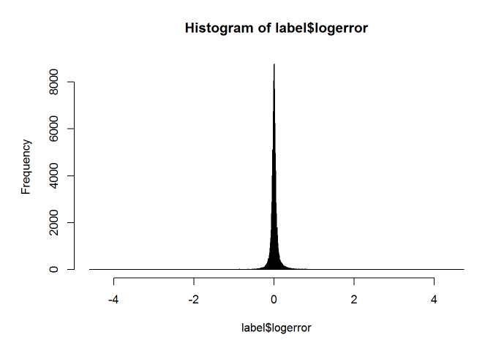
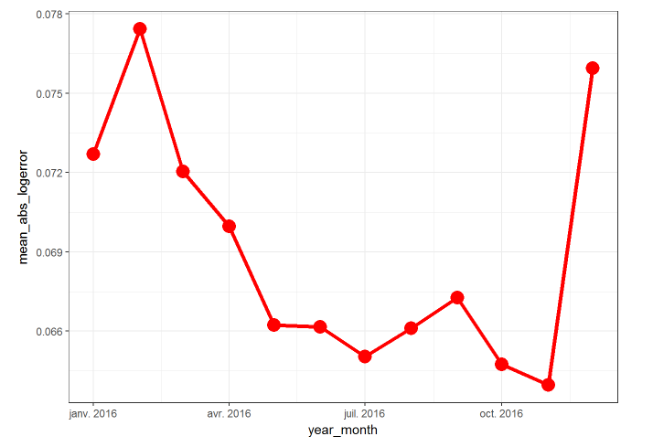
Explolatory Data Analysis
Overview
One can simply put the entire data to a blackbox model and get the results.
But one can also spend time to understand the data hence get the very first ideas for better modelling.
Outliers in the response: capping / collaring could be beneficial.
Necessarily of making several models.
Response variable changes over time -> How to deal with this issue?
Try different weights for observations of different months.

Slide 5
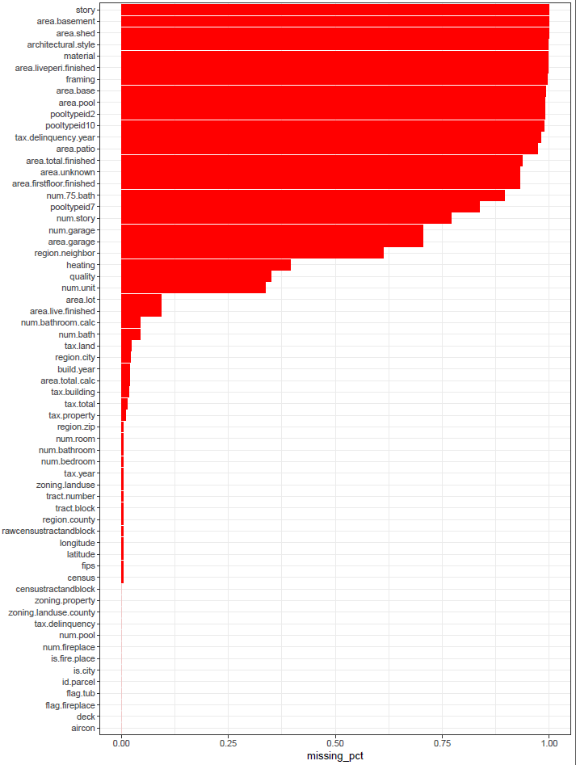
Explolatory Data Analysis
Missing value
Remove predictors with more than 98% missing value.
Data imputation:
Replace NA by extreme value (-1, -999)
Replace NA by the median
Build a simple model to predict the missing value
Replace by a value that make sense.
The choice between two methods is done by heuristic.

Slide 6
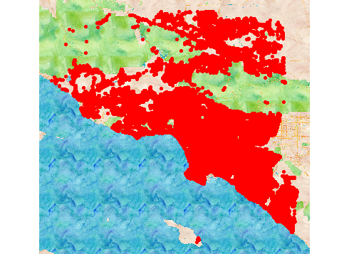
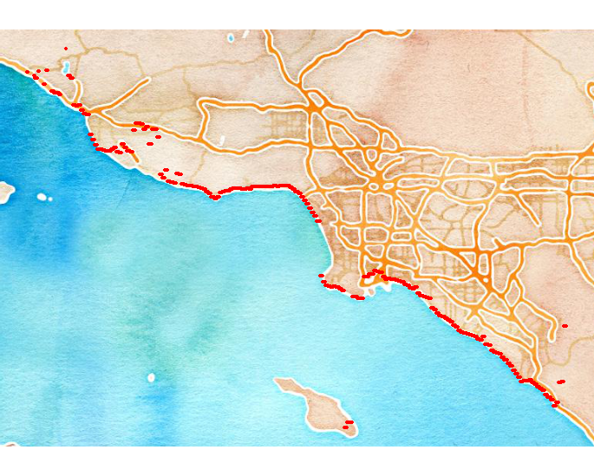
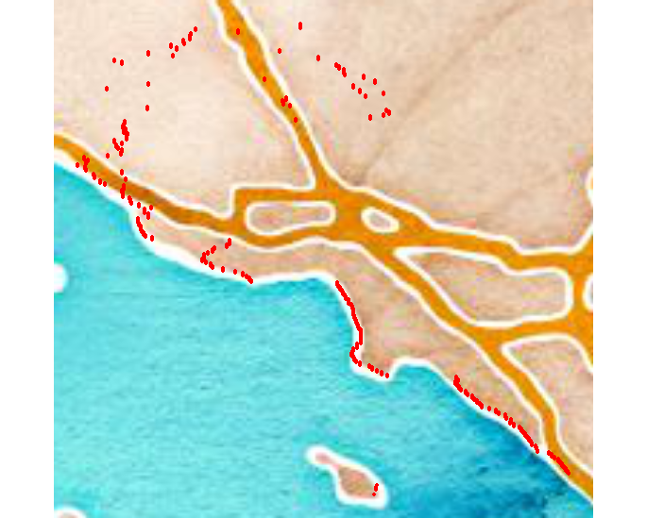
Feature Engineering
Ocean Distance
Ocean distance
The intuition is that the nearer to the coast a house is, the more expensive it becomes.
External data is not allowed, so we need to calculate the longitude / latitude of the coast from the available data.
We can take the
min of longitude by different groups of latitude
Min of the latitude by different group of longitude
And combine them to have the desired information without using external data

Slide 7
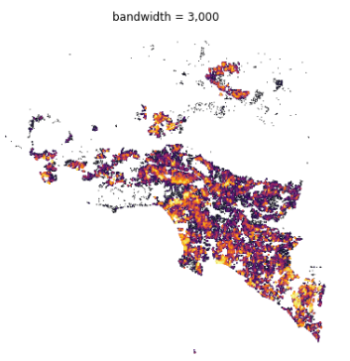
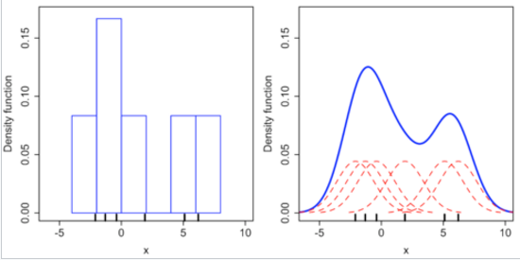
Feature Engineering
Parcel Density
Kernel Density Estimation
Kernel density is the non-parametric estimation of the probability density function (PDF) of a given data point.
Example of 1-dimension KDE:
The data points here are the geographical coordinate of the houses.
The non-parametic nature of the technique allows us to easily fit the data on a 2-dimension space and on each local segmentation.
It gives us an additional information of how concentrated the parcel is, independently from the pre-defined geographical zone.
Reference: https://en.wikipedia.org/wiki/Kernel_density_estimation

Slide 8
Modelling
Penalized Regression Models
4.Modelling phase 1
5.Modelling phase 2
.Building simple models on the whole data:
Lasso regression
Ridge regression
Elastic net
Tree bases models:
Random Forest
Gradient Boosting
Intuition: Zillow model already doing well on the traditional variables (not the longitude and latitude).
So we can:
First, fit all the traditional variables to the zestimate residuals to complete Zillow model
Fit the second model only on longitude & latitude with some special treatments.
With splines
6.Modelling phase 3
.Building 3 different models for 3 different cities, as the impact of each predictor on the price is not the same between each city.
Building n models for n clusters.

Slide 9
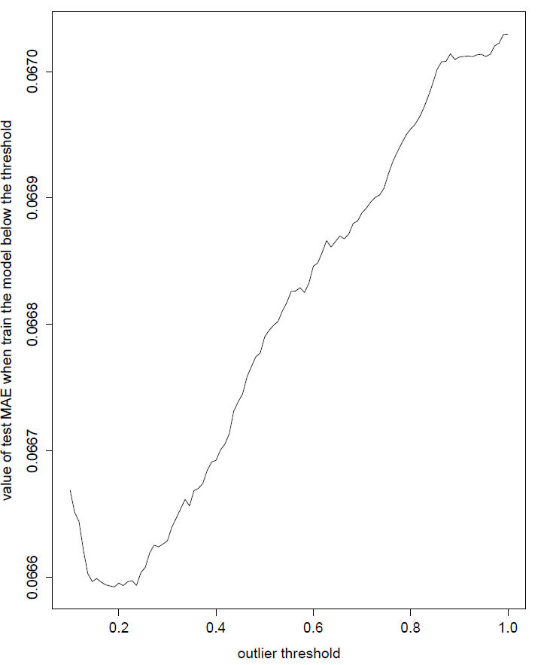
Some little tricks
Outlier threshold detection
Outlier threshold detection
Build n regression models on different training set with n levels of outlier threshold.
Measure the their performance on an independent testing set without threshold.
The model’s performance is strongly impacted by the choice of this threshold as shown in the graphics.
Optimal threshold

Slide 10
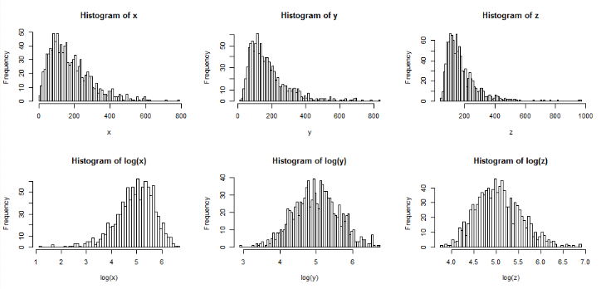
Some little tricks
log-transformations of right-skewed variables
Log transformation
Log – transformation of a right-skewed variable:
Makes its distribution looks more normal,
Pulls the extreme values on the right closer to the median.
Pushes the extreme values on the left further away from its median.

Slide 11
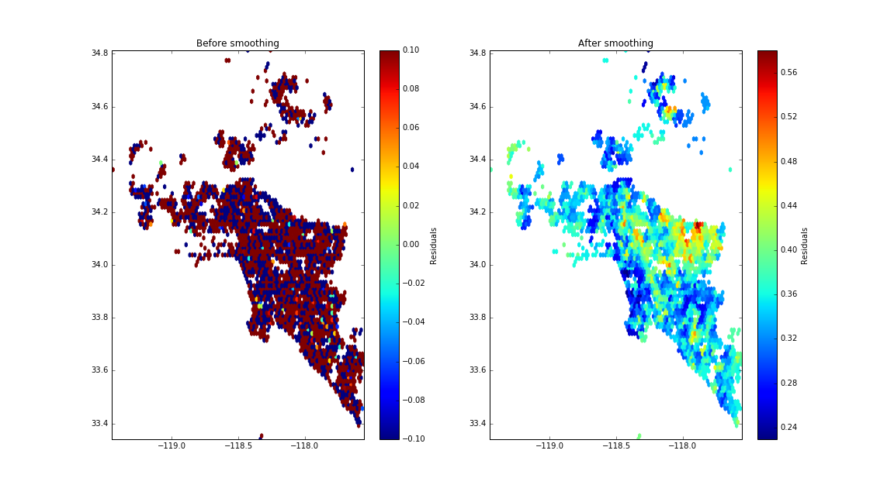
Spatial Smoothing
K-nearest neighbors
Spatial smoothing was done using the automated tool of AGD.
Input:
longitude
latitude
residuals (from a simple model)
exposure
Output: smoothed residuals by 3 classes.

Slide 12
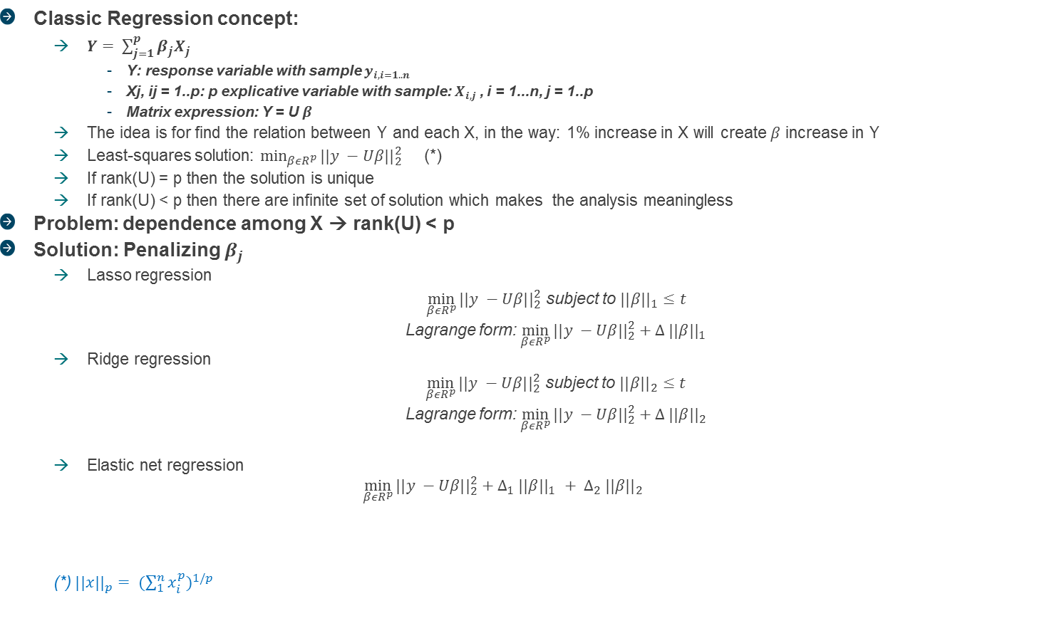

Penalized Linear Models
LASSO, RIDGE and ELASTIC NET
Classic Regression concept:
$Y= \sum_{j=1}^{p}{β_{j}X_{j} }$
Y: response variable with sample $y_{i, i=1..n}$
Xj, ij = 1..p: p explicative variable with sample: $X_{i, j}$, i = 1...n, j = 1..p
Matrix expression: Y = U $β$
The idea is for find the relation between Y and each X, in the way: 1% increase in X will create $β$ increase in Y
Least-squares solution: $\min_{βεR^{p}}{{||y −Uβ||}_{2}^{2}}$ (*)
If rank(U) = p then the solution is unique
If rank(U) < p then there are infinite set of solution which makes the analysis meaningless
Problem: dependence among X → rank(U) < p
Solution: Penalizing $β_{j}$
Lasso regression
$\min_{βεR^{p}}{{||y −Uβ||}_{2}^{2}}$ subject to ${||β||}_{1}≤t$
Lagrange form: $\min_{βεR^{p}}{{||y −Uβ||}_{2}^{2}}+∆ {||β||}_{1}$
Ridge regression
$\min_{βεR^{p}}{{||y −Uβ||}_{2}^{2}}$ subject to ${||β||}_{2}≤t$
Lagrange form: $\min_{βεR^{p}}{{||y −Uβ||}_{2}^{2}}+∆ {||β||}_{2}$
Elastic net regression
$$\min_{βεR^{p}}{{||y −Uβ||}_{2}^{2}}+∆_{1} {||β||}_{1} + ∆_{2} {||β||}_{2}$$
(*) ${||x||}_{p}= {(\sum_{1}^{n}{x_{i}^{p}})}^{1/p}$

Slide 13
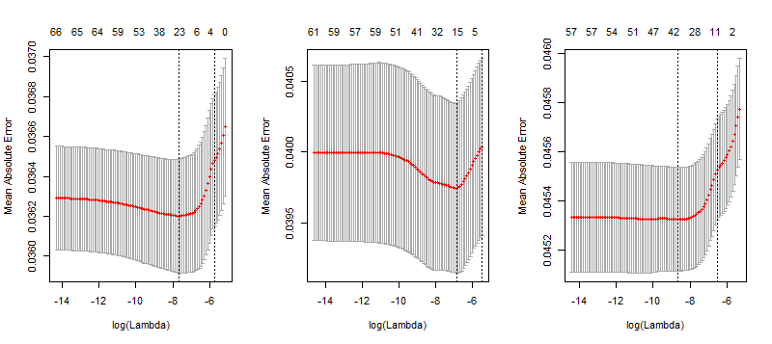
Penalized Linear Models
LASSO
Begin with a simple model, then enrich it with the more complicated models later on.
3 populations from 3 counties have different best lambda.
Dividing the population by 3 leads to a trade-off between variance & bias.
The less populated county has the largest lambda’s variance, it’s worth regrouping this county together with the third one.
Ridge Regression & Elastic Net have also been tested but didn’t provide better CV (and LB) results than Lasso.

Slide 14

GBDT family
GBM
The traditional boosting algorithm by Breiman & Friedman.
Ensemble of trees, to fit the objective function:
$$obj(φ)=\sum_{i}^{n}{l(y_{i},\hat{y_{i})}}$$
$\hat{y_{i}}=\sum_{k=1}^{K}{f_{k}(x_{i})}$
Easy to tune & good accuracy
Slow training

Slide 15
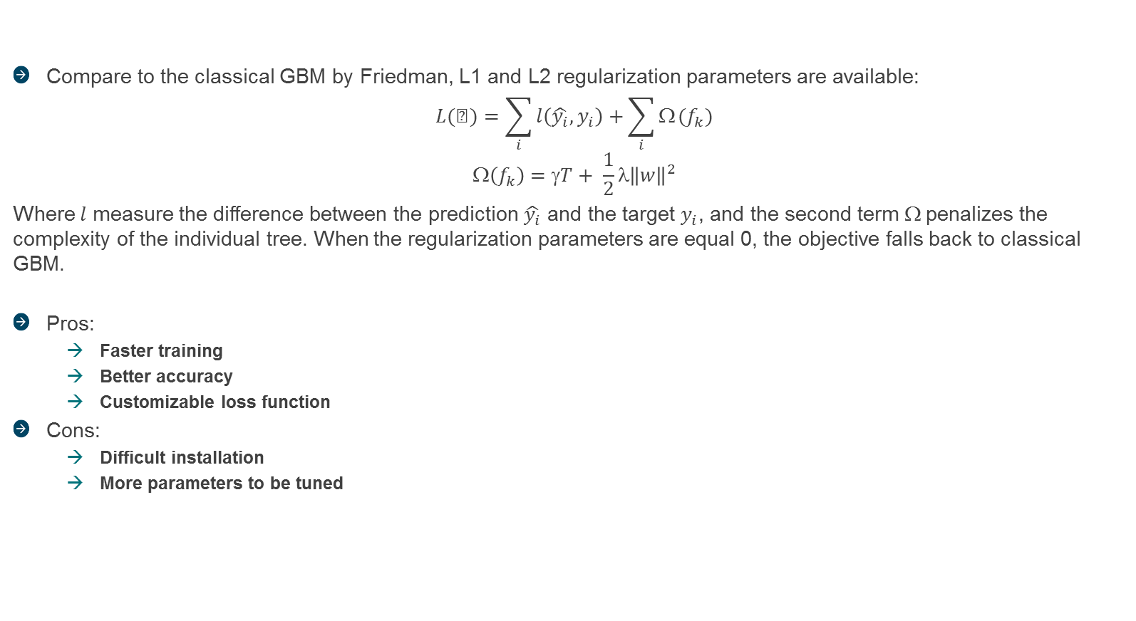
GBDT family
XGBoost (Penalized Gradient Boosting)
Compare to the classical GBM by Friedman, L1 and L2 regularization parameters are available:
$$L(φ)=\sum_{i}{l\left(\hat{y_{i}},y_{i}\right)+}\sum_{i}{Ω}(f_{k})$$
$$\left(f_{k}\right)=γT+ \frac{1}{2}λ{\left\|w\right\|}^{2}$$
Where $l$ measure the difference between the prediction $\hat{y_{i}}$ and the target $y_{i}$, and the second term $$ penalizes the complexity of the individual tree. When the regularization parameters are equal 0, the objective falls back to classical GBM.
Pros:
Faster training
Better accuracy
Customizable loss function
Cons:
Difficult installation
More parameters to be tuned
XGBoost parameters | General parameters |  | nthread | number of parallel threads
 |  |  | booster | gbtree or gblinear
 | Booster parameters |  | eta | shrinkage parameters
 |  |  | gamma | minimum loss reduction required to make a split
 |  |  | max_depth | maximum depth of a tree
 |  |  | min_child_weight | minimum sum exposure needed in a child
 |  |  | subsample | subsample ratio of the training sample
 |  |  | colsample_bytree | subsample ratio of columns when constructing each tree
 |  |  | lambda | L2 regularization on weights
 |  |  | alpha | L1 regularization on weights
 |  |  | lambda_bias | L2 regularization on bias
 | Task parameters |  | objectives | regression / classification
 |  |  | evaluation_metric | mae, rmse, logloss, customized loss, ….

Slide 16
GBDT family
Dynamic Boosting - Catboost
GBM, XGBoost, LightGBM are susceptible to a bias in a pointwise gradient estimates that lead to reduced accuracy.
Catboost proposes a dynamic boosting approach that avoids the estimation bias at a minimal cost of variance.
Catboost can outperform tuned GBM, XGBoost, LightGBM even with its default parameters.
Catboost works well with categorical features.
Catboost doesn’t have good training time.
Mathematical background of dynamic boosting can be found at: https://arxiv.org/abs/1706.09516

Slide 17
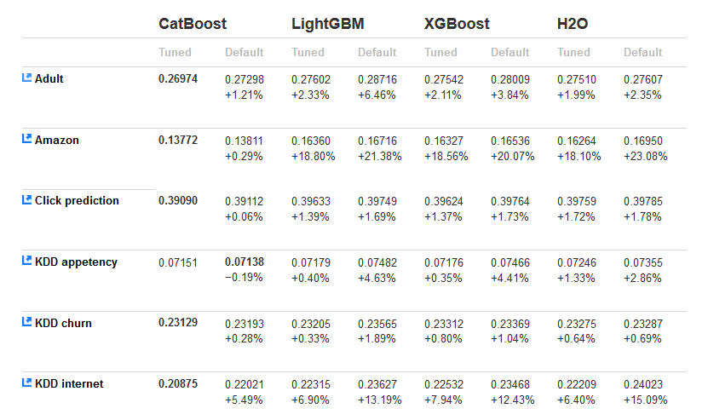
GBDT family
Benchmark
Logloss values for classification tasks obtained by different models on several data sets.
CatBoost outperforms other model of the GBDT family even with its default parameters.

Slide 18
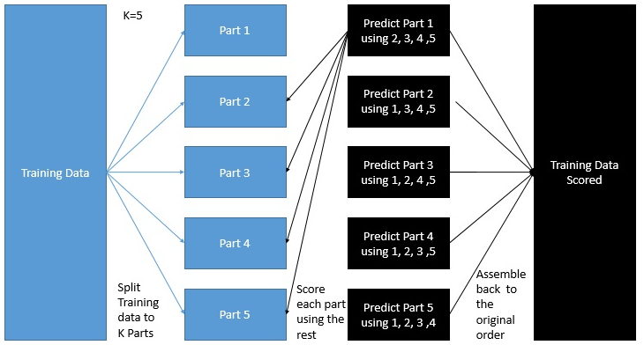
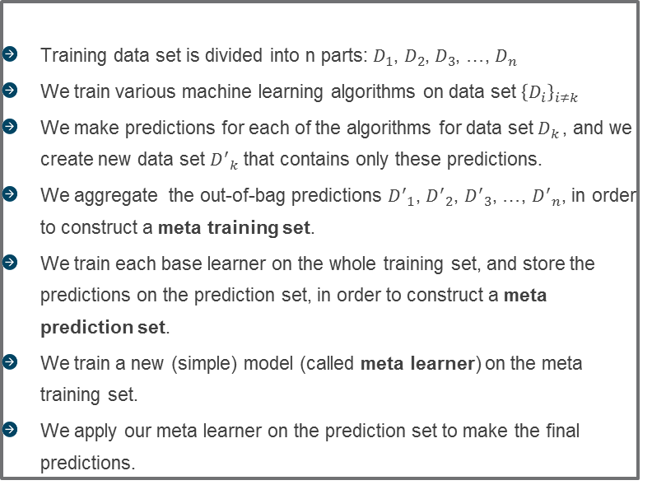
Stacking
Combination of models
Overview
Stacking consists of combining predictions of different models to make a new model. It leverages the best of each model, and discredit the base model where it performs poorly.
The metal model for stacking is often simple, and resistant to outliers (ex: quantile regression)
Details
Training data set is divided into n parts: $D_{1}$, $D_{2}$, $D_{3}$, …, $D_{n}$
We train various machine learning algorithms on data set ${\left\{D_{i}\right\}}_{i≠k}$
We make predictions for each of the algorithms for data set $D_{k }$, and we create new data set ${D^{′}}_{k}$ that contains only these predictions.
We aggregate the out-of-bag predictions ${D^{′}}_{1}$, ${D^{′}}_{2}$, ${D^{′}}_{3}$, …, ${D^{′}}_{n}$, in order to construct a meta training set.
We train each base learner on the whole training set, and store the predictions on the prediction set, in order to construct a meta prediction set.
We train a new (simple) model (called meta learner) on the meta training set.
We apply our meta learner on the prediction set to make the final predictions.

Slide 19
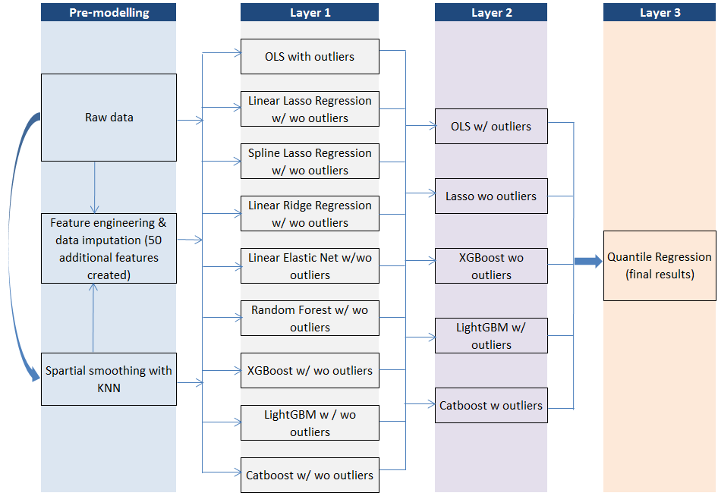
Final Solution

Slide 20
Resumé
Lessons learned
Creative feature engineering makes the difference.
Careful treatment of outliers is important.
Spend time on parameter tuning is worth doing
What’s more?
Time series analysis on the change of the absolute value log-error over time.
Clustering the data into groups.
Better and proper stacking.
Better models with spline (Emblem?)
Special treatments of spatial features.

